Slide 1
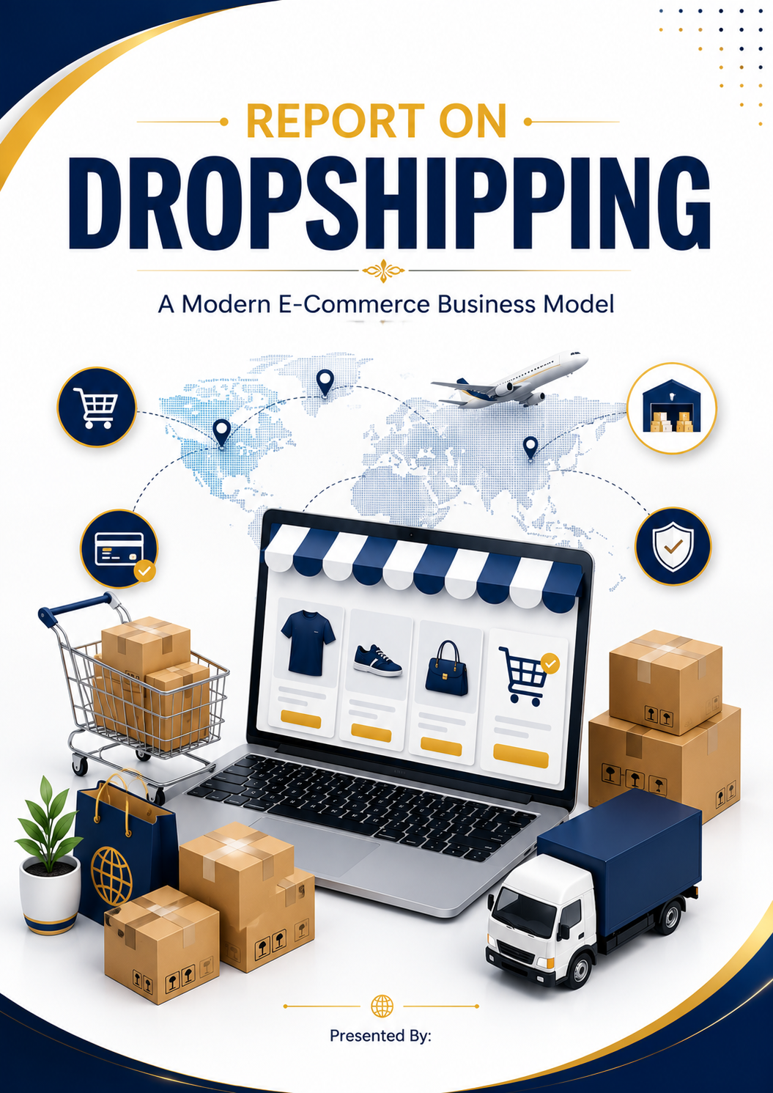
Syed Maseehulla Nauman

Slide 2
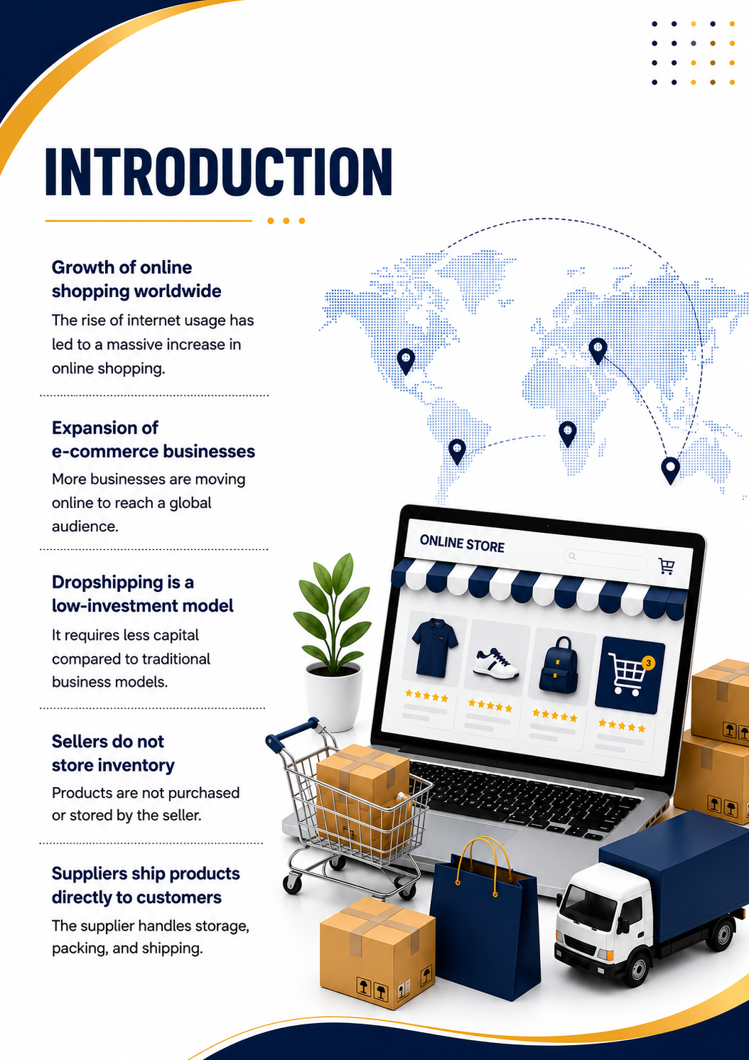
INTRODUCTION
Growth of online shopping worldwide
The rise of internet usage has led to a massive increase in online shopping.
Expansion of e-commerce businesses
More businesses are moving online to reach a global audience.
Dropshipping is a low-investment model
It requires less capital compared to traditional business models.
Sellers do not store inventory
Products are not purchased or stored by the seller.
Suppliers ship products directly to customers
The supplier handles storage, packing, and shipping.

Slide 3
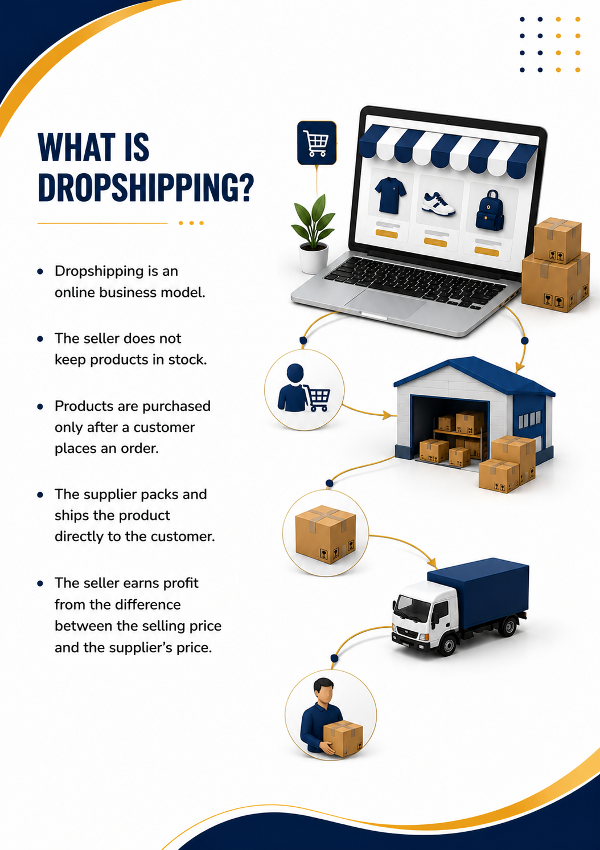
WHAT IS DROPSHIPPING?
Dropshipping is an online business model.
The seller does not keep products in stock.
Products are purchased only after a customer places an order.
The supplier packs and ships the product directly to the customer.
The seller earns profit from the difference between the selling price and the supplier's price.
WHAT IS DROPSHIPPING?
Dropshipping allows businesses to sell products without buying or storing inventory.

Slide 4
HOW DROPSHIPPING WORKS
Step 1: Customer places an order on the online store.
Step 2: Seller receives the order and forwards it to the supplier.
Step 3: Supplier prepares and packs the product.
Step 4: Supplier ships the product directly to the customer.
Step 5: Customer receives the order, while the seller earns a profit.
The seller acts as a bridge between the customer and the supplier without handling inventory.

Slide 5
HOW DROPSHIPPING WORKS

